Slide 1
Build a basic Connector
Connector Registration

Slide 2

Connector Registration
Connectors Developer Dashboard
Connector Submission Checklist

Slide 3
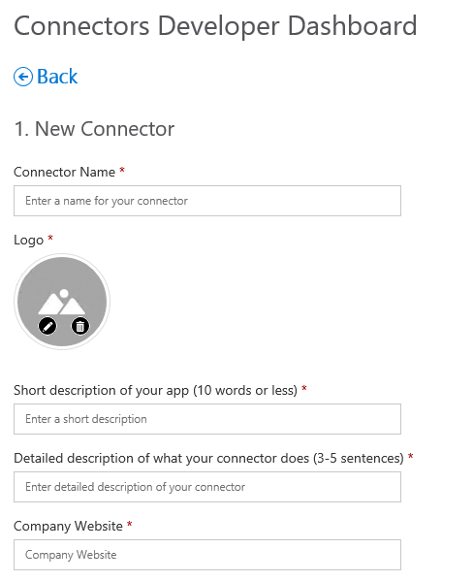
Connectors Developer Dashboard
Register a Connector
New Connector section
Field | Notes
Connector Name | Shown in connector list
Logo | Shown in connector list
Short description | Shown in connector list
Detailed description | Shown when adding / configuring a connector
Company website | Shown when adding / configuring a connector
Notes:
Provide data in well-defined fields. Rendering is handled by host application

Slide 4
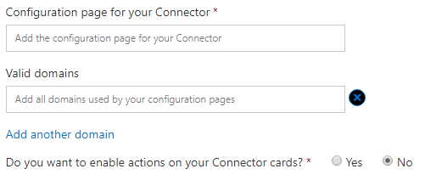
Connectors Developer Dashboard
Register a Connector
New Connector section - continued
Field | Notes
Configuration page for your Connector | Displayed to user during configuration
Do you want to enable actions on your Connector cards | Used for Actionable cards
Valid domains | Used for Actionable cards
Notes:
Provide data in well-defined fields. Rendering is handled by host application

Slide 5
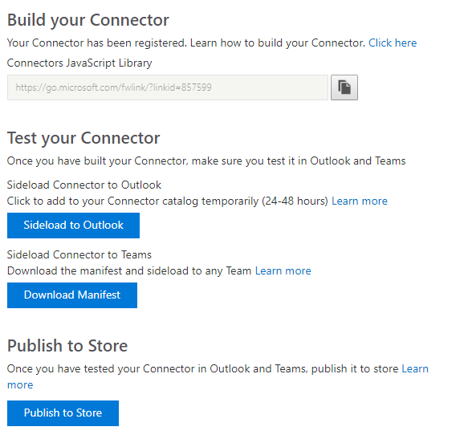
Connectors Developer Dashboard
Register a Connector
Build/Test section
Field | Notes
Connectors JavaScript libary | Link to the Microsoft Teams javascript SDK
Sideload to Outlook | Adds the connector to the Connectors list for the user’s Inbox
Download Manifest | Generates and downloads a manifest.json file for creating a Teams app
Publish to Store | Initiates the publish process for publicly-available connectors
Notes:
Provide data in well-defined fields. Rendering is handled by host application

Slide 6
Connector submission checklist
Developing your connector
Test connector cards in various clients
Ensure you use Markdown, not HTML
Maintain balance between adding value and generating noise
Identify the right events to send connector cards for
For reports or summaries
Use the digest format
Allow user to configure time & frequency
Actions should have low failure rate and fast response
Implement HTTP 302 or referrer policy on the callback URL
Registering your connector
Ensure name & logo does not infringe upon trademark or copyright
Provide high-quality logo
Provide a short description of your application
Provide a detailed description of your connector
Have clear user-facing documentation
When publishing
Fill out step-by-step instructions
Provide test credentials
Notes:
When registering your connector:
Ensure that the name and logo of your connector does not infringe upon a trademark or copyright of any other product or service.
Provide a high quality logo of type jpg, jpeg, png or gif that is under 60KB in size.
Provide a short description of your application (e.g. 'Contoso Helpdesk brings companies & customers together').
Provide a detailed description of your connector (e.g. 'The Contoso Helpdesk connector notifies your Office 365 group about activity on your customer's tickets').
The landing page for your users is the page where users would be directed to complete the connector configuration. Make sure that you deep link to the page where you have added the connect button. If this is not possible, point this to your documentation page that has detailed on how to setup your connector.
When publishing your connector to Store:
Make sure to fill out step by step instructions and share test account information to let us test your connector.

Slide 7

Summary

Slide 8
Thank you

